Slide 1

Welcome! We’re glad you’re here.
All slide transitions are random
Notes:
Welcome to BridgeConf! You're going to like it. I'm Thomas Rayner, and on behalf of the other BridgeConf organizers, Adil and Cory, I'd like to talk to you about our community.

Slide 2
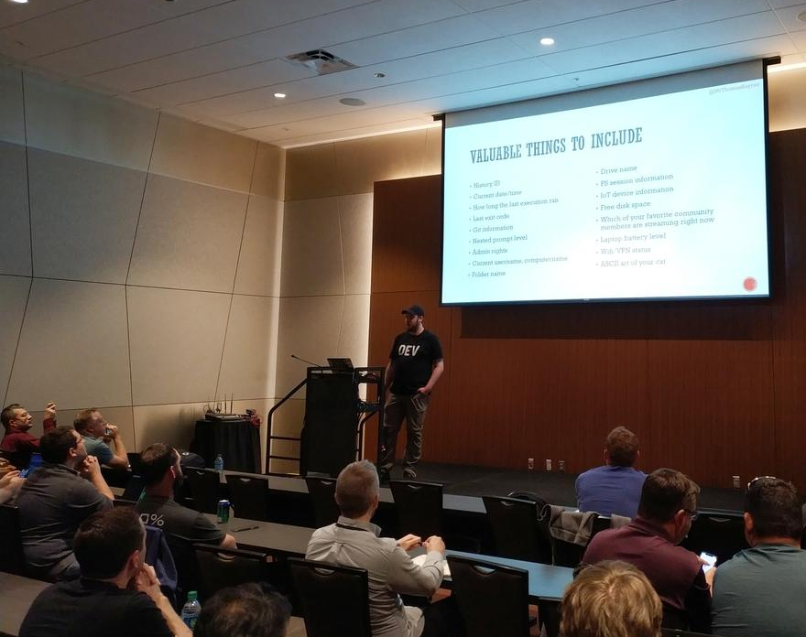
What is #BridgeConf?
By the community, for the community.
Notes:
If you're asking yourself "What is BridgeConf?", I can answer that for you. There's a PowerShell Discord-Slack bridged network, which also includes IRC if you're old and a curmudgeon that I, and a few thousand others like to spend time on. The most popular and socially engaging channel on the network is named Bridge. Hence, BridgeConf. We didn't create this network. That was Joel "Jaykul" Bennet who made the original PowerShell channel on Freenode's IRC network in 2006.
We love our in-person events like the PowerShell and DevOps Global Summit, but that's canceled, and for good reason. Summit was originally scheduled to be going on right now, which is why we scheduled BridgeConf today. We knew everybody who was planning on attending Summit would be free.
To celebrate our community, Adil, Cory and I thought we should all do what we all in this community do best. That is, share information with each other, help make each other better, and try and have a little fun while we do it.
In our call for proposals, we asked speakers to submit sessions on topics that excite them. Their submissions did not disappoint, and I'm really excited for each of them. I wish we could have every proposed session presented today. What excites us, the organizers, though, is this community of incredibly knowledgeable, helpful, and generous professionals.
BridgeConf is a 100% grassroots, community driven effort. By us, for us.

Slide 3
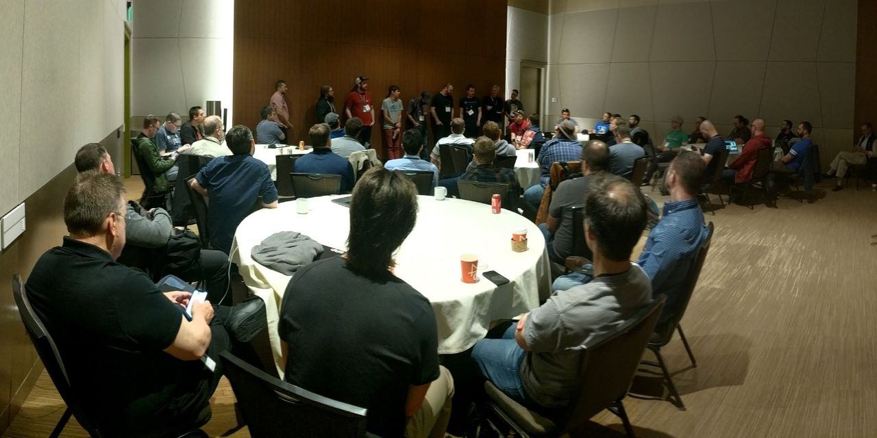
Stronger together
Notes:
Humans are social creatures, even those of us who are introverts.
Most of the knowledge humans know has been shared with us by another human. The rest of it is stuff you figured out on your own, through your own experiences. The majority, though, is taught to us.
In our society, we don't all grow our own food or fly our own planes. We aren't all proficient tradespeople. We don't all know how to keep online banking secure, or how to automate the silent installation of Adobe Reader. We can't all resolve git merge conflicts, or know how to display an OpenFileDialog box in PowerShell. We depend on the knowledge, and the effort of others. Do you see where this is going?
Computers are basically just rocks that we pumped electricity into and tricked into thinking. They're just another tool, among many, in our society. Everything we know about technology right now is learned through humans who share their experiences and knowledge with others. The same is true about our collective human knowledge on agriculture, trades, aviation, distributed source control, and end-user interfaces. Think how far behind your peers you'd be if you had to rebuild this enormous collection of knowledge through trial and error - through your own experiences.
Without our community, we'd be without socialization. We wouldn't have culture, trust, honesty, or love in any of the ways that we think about them. We'd be lost, figuring everything out as we go, painfully and slowly in isolation.
Our survival depends on a community of other people spreading knowledge, and exchanging the product of their effort. Our society depends on the socialization that happens within communities.
We are truly better, and stronger together.

Slide 4
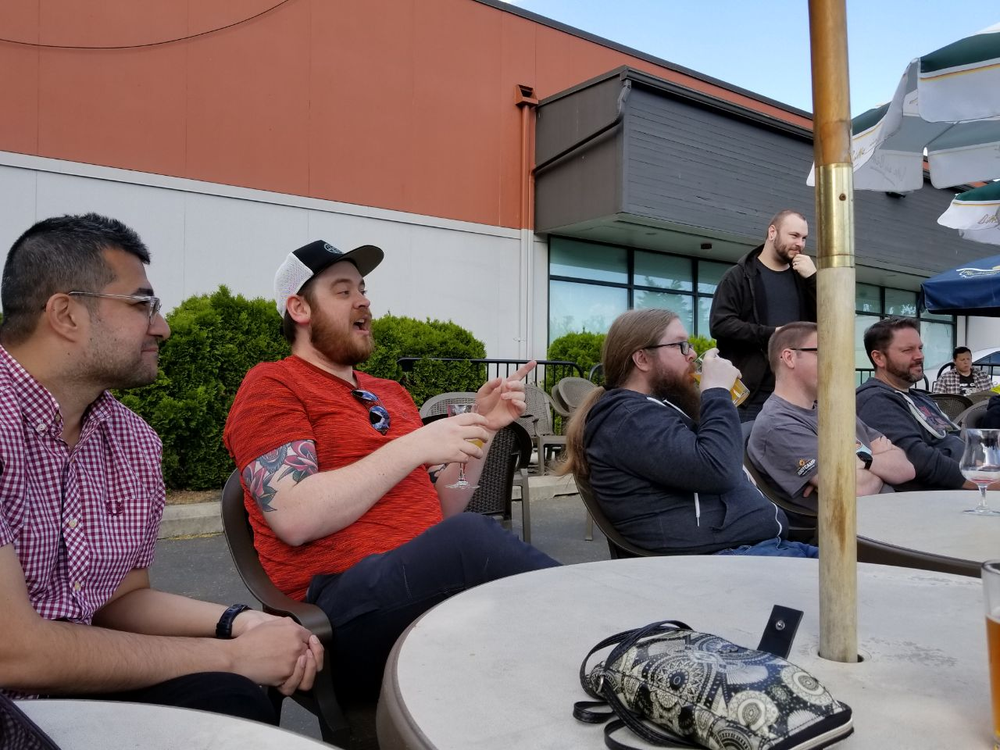
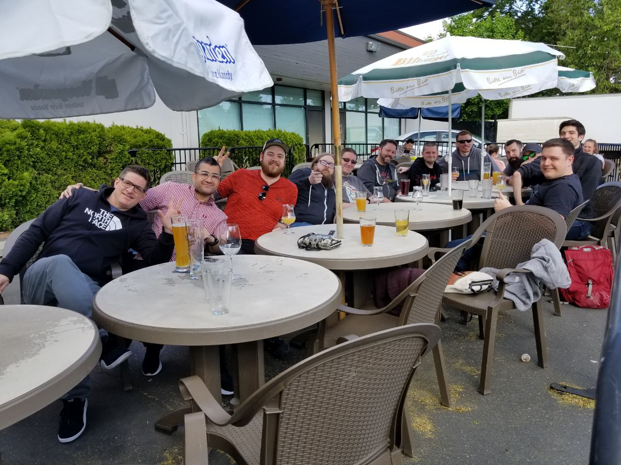
More than socializing
Notes:
Philosophy aside, our specific community of technology professionals matters for more than just how we socialize, although, we're known to enjoy getting together for a beverage and some banter.
All technology is invented, and provided by humans who specialized in that field to empower other humans, even Artificial Intelligence. Technology helps humans do things faster, like perform mathematical calculations. It makes life safer for humans when we send IoT devices into places that are dangerous for humans to go, or when a factory has alarms in place to help assure the safety of the humans inside it. Technology has made us humans increasingly more productive by amplifying our existing skills and abilities. Technology invented by humans also helps do things from further away, like stay in touch with people we care about, and exchange knowledge with people we'd never otherwise meet.
PowerShell is a technology invented by Jeffrey Snover and a team at Microsoft for system administrators. It helps admins automate away mundane, repetitive tasks, and reduce errors as they work. PowerShell empowers an entire class of IT professionals to do more, better.
We're all standing on the shoulders of the people who have been here before us, hopefully to create more progress of our own. Hopefully to empower ourselves and others, in addition to how we've been enabled already. Then, maybe others can come after us, and use our work to better people's lives in even more ways than we did. That's what BridgeConf, and all other conferences, are really about, fundamentally. That's what's happening every time you participate in a community. Sharing knowledge empowers people to be better than they were before.
Everything we do in our community matters. Whether it's helping someone get unstuck at work, teaching someone something new, giving an answer to someone who's experiencing an outage-related emergency, or even referring someone to a new, more exciting role. It's not about gigantic, overwhelmingly abundant and meaningful contributions, although those exist and are great. It's about a thriving community, made up of many members, each helping each other grow, learn, and progress, and in exchange receiving help from others to do the same.

Slide 5
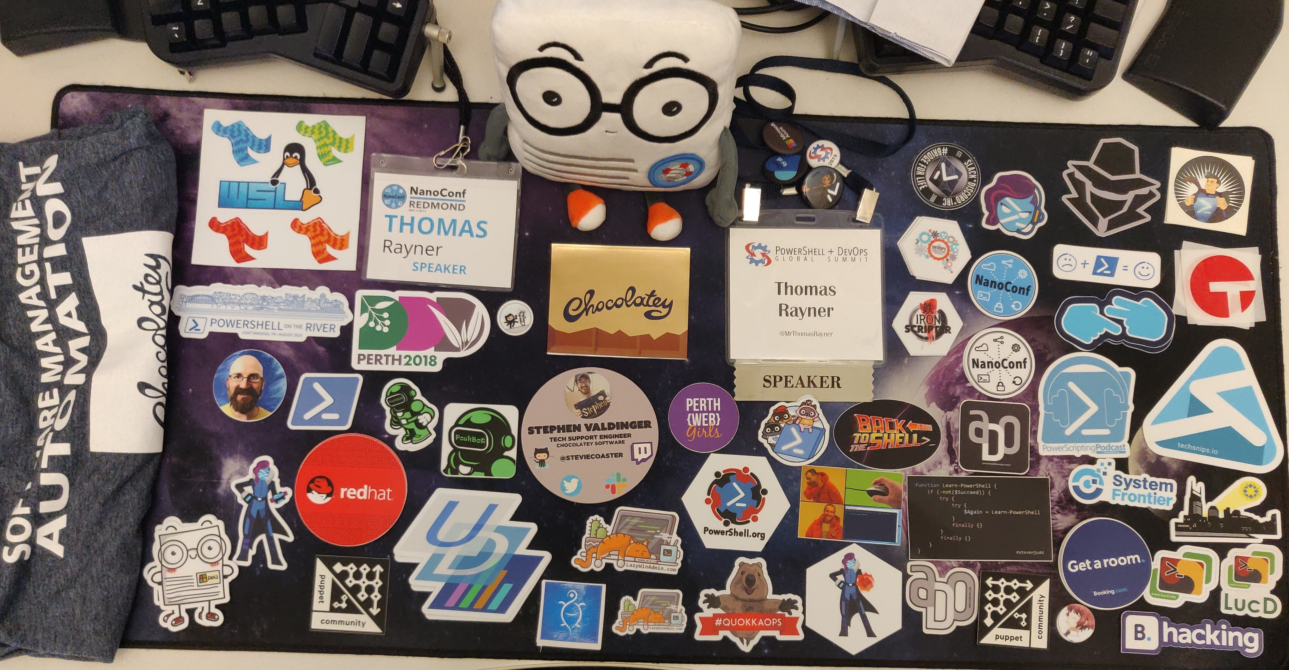
What goes around comes around
Notes:
Whether or not you believe in karma, it's undeniable that one's participation in this community of technology professionals comes back around to benefit oneself. For instance, I've received WAY more stickers and cool swag than I've ever given out.
Every day, we all read documentation and blog posts written by other people. We all read answers to previously asked questions on online forums, and watch videos to further our own knowledge. Many of us attend conferences, for the same reasons. All of us at some point have asked for help and got it, in some way or another.
Participating in the community allows you to do more than just help someone else in that specific moment in time.
Answering someone's question on Discord is great, and gets that person unblocked on whatever they were working on in that moment. Good for them! Good for you, too, though. Others see your contribution, and you grow more connected to your peers in the community. You're building a crucial network of peers just by hanging out in Discord, chatting with others, answering questions.
Maybe you contribute to an open source project, and add a new feature that people get to use. Others benefit from your feature, absolutely, but you also benefit by learning new things through the development process, and suddenly you're an expert on something - whatever it is you built. Maybe this open source contribution opens up new opportunities for you to grow, and speak at user groups on this thing you're an expert on now.
How about if there's a conference you want to attend? It's going to have sessions from speakers you're a huge fan of. It'll be an incredible learning opportunity, and a chance to meet and network with plenty of people that you want to connect with. But, your employer doesn't have the budget to send you. The conference, however, pays for the expenses of people who are speaking at the conference. So, you submit a few sessions and one of them is about the feature you made on that open source project. The organizers know who you are from your work, they've seen you around on Discord and Twitter, and they can refer to the recording from the user group you spoke at to see you're a qualified speaker. Based on all these things, your session is selected for the conference. Now you get to go and learn from all your heroes, connect with talented and interesting people, advance your career, all for free. What goes around, comes around.
One more example. Maybe you have a blog, and over time amass a pretty significant body of work. Hundreds of people visit your blog every month and benefit from the knowledge you share. Maybe one of those people works for Microsoft, likes what they see, and thinks you might be a good fit on their team. Their team just happens to have an opening coming out, so they reach out to you and solicit your application. This one's a bit personal for me. That's basically the story of how I got my job at Microsoft.

Slide 6
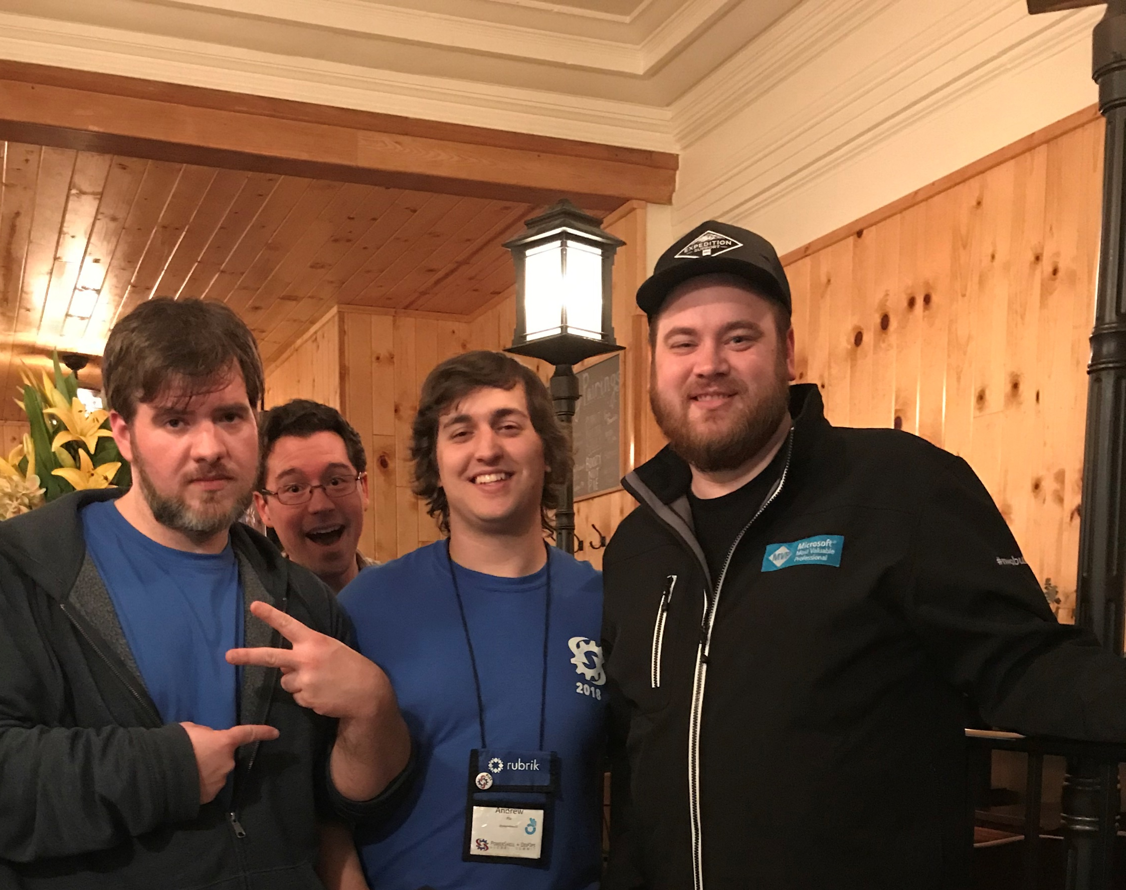
Advancing your career
Notes:
Participation in the community will directly benefit your career. The example I shared about myself is just the tip of the iceberg. I've genuinely lost count of the people whose careers I've seen helped through being a part of the community.
The time of having a career where you get hired out of college, work at the same company for 25 years, and retire, are fading. People are working longer, and that makes for fewer opportunities for advancement.
But, there are more and more places to work that never used to exist. New firms, empowered by technology, with reduced barriers to entry seem to pop up every week. Increasingly, remote work is opening up job markets that didn’t exist, or weren't accessible even a few years ago. You can live in Idaho, and work in Silicon Valley, now. You're not limited to the companies you can drive to every morning. Additionally, there are new roles at existing companies who are changing and growing to stay competitive with all the new firms I just mentioned. This industry is evolving, and changes quickly.
So, I'd encourage you to ask yourself, and really spend some time thinking about, what is your next career goal? Is it to work from home? To have more flexible hours? Do you want more money? Or to work on something more challenging or interesting? Do you want to be an organizational leader? How do you get a role like the one you want next?
Can you achieve this where you're at now? If you can, that's awesome. Still, a body of work is going to help convince others of your qualifications. But increasingly, the answer is becoming "no, I'm going to need to move to a new organization to reach my career goals in a reasonable amount of time".
So, how do you find out about new roles? Sure, there are lots of job hunting websites, but leaving one company for another is a big deal. This is your career, and shouldn't be taken trivially. How do you find out if the new company you're thinking about working at is a good place to work? How do you find out if the role you're looking at is one that's actually aligned to your goals? Wouldn't it be nice to know a little bit about the hiring manager before signing your offer letter? How do you stand out among all the other applicants if you do decide this is the next role for you?
The answer to all these questions, is having a network of other professionals.
Your network can help you find out about new roles before anybody else. The people you know can help you get an inside track on what the new company and role is actually like. A REFERRAL will get you an interview, even when the hiring manager is going numb after reading 100 other resumes.
You can be the best in the world at what you do, but how does anybody else know that? Resumes and modern HR systems are imperfect. Even the technology industry is still a people-oriented business.
How do you grow your network of other professionals? How do you get this immensely valuable leg up on the rest of your competition? By being active in your technical community.

Slide 7
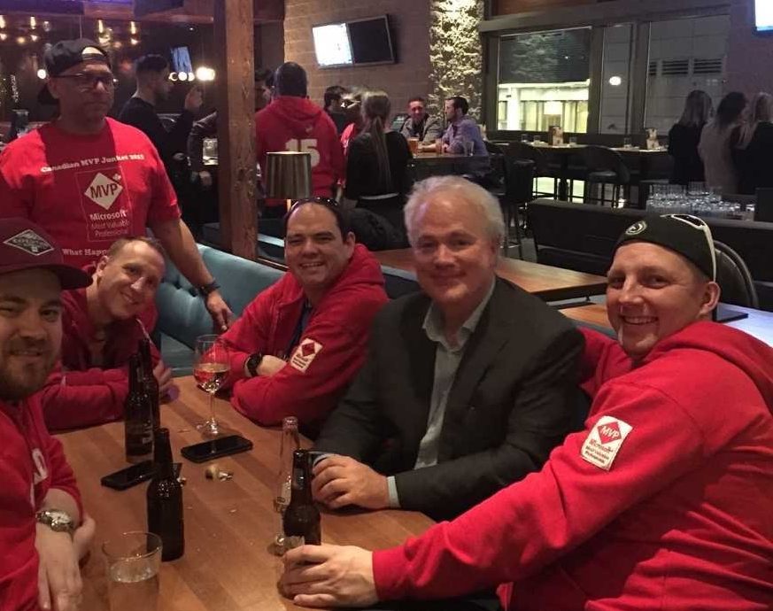
Nobody is keeping score
Notes:
You're already a participant in this global community of technology professionals whether you know it or not.
Every time you read a blog post, or get your question answered in a forum, contribute to an open source project, read a book, or watch an online virtual conference, you're consuming the product, and learning from someone else in the community. This is why it's so critically important that we all participate in whatever way we find comfortable. Not everybody is comfortable public speaking, and not everybody is a prolific writer. But, everybody has something unique to share, even a unique perspective matters. Nobody has the exact set of knowledge you do, and nobody has the same perspective you do. You don't have to be an expert.
The only barrier to sharing knowledge is the one you set yourself. Don't defeat yourself before you even get started or try. Nobody is telling you "no", but you. A unique perspective on an established topic is valuable. Many important concepts can never have enough coverage.
In a distributed community, diversity of information sources is crucial. If we all get all our information from one source, we'll become biased. Even if that one source is well-intentioned. We need other perspectives, it builds empathy. It's healthy and important to share your opinion constructively. Plus, spreading the load of sharing information decreases the community's dependence on individual contributors. If we get all our information from four different people, what happens when one of them retires? We always need more voices. There is always room.
Not everybody wants a million Twitter followers, or to speak in front of a few hundred people, or to become a best-selling author. But, helping one person, in a fleeting chatroom moment, matters. It definitely matters for that person that got helped. One day that person being helped will be you. Odds are, it probably already has been, before.
This isn't a competition. Comparing your contributions to the contributions of others isn't worthwhile or productive. There is no master ledger keeping track of how many people you help versus how many people helped you.

Slide 8
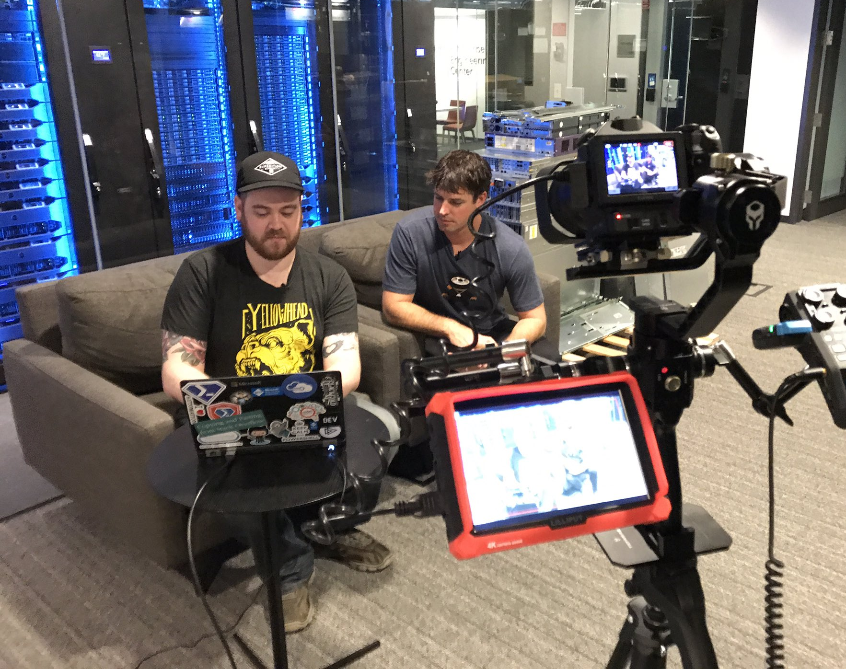
A world of opportunity
Notes:
There are no limits on how you can interact with our community of technology professionals.
Starting a blog, writing a book, speaking at a conference, answering questions online, and contributing to open source projects are all popular options, but they are not the only options. Posting a job opening at your company on Twitter is community participation.
Technology empowers us to constantly find new and interesting ways to share knowledge. There is something out there for everyone, and if there isn't, there's an opportunity to create something new. There is no one size fits all solution.
Think about what resources you wish you'd had at different points in your career. Think about what resources are already out there, but are imperfect and need improvement.
You don't need anybody's sign off to join GitHub, or Discord, or Slack, or Twitter, or to create a blog. You do not need anybody's permission to make the world better.

Slide 9
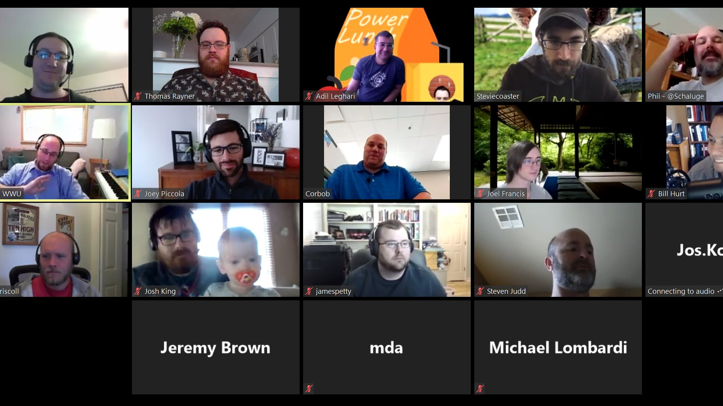
Can’t stop community
Notes:
Now, maybe more than ever, the importance of our community is crystal clear. Many of us would be at the PowerShell and DevOps Global Summit right now, if it wasn't for all the trouble that current world events have caused.
In-person events do more for us than provide a venue to exchange technical information. They provide an opportunity for socialization. Socialization and comradery are important to maintain, even in a world that's obliged to participate in social distancing. It's important for our mental health. Socialization is a part of our sense of belonging and purpose.
Connecting to other humans matters, and it just so happens that this community is made up, entirely, of humans.
The knowledge we share in our community is valuable to others, and there are personal advantages to be enjoyed that come from sharing knowledge. Having a community is important for more than just knowledge, though. It's important for us as people, making the best for ourselves and others in this society.
Our community bands together to find solutions to problems. It can't be stopped. It will persevere. We're all there for each other, especially now. And if you need help, whether it's figuring out how to get that OpenFileDialog box to open, finding your next role, or staying well-adjusted through a tumultuous time, there are other people out there who want to help.

Slide 10
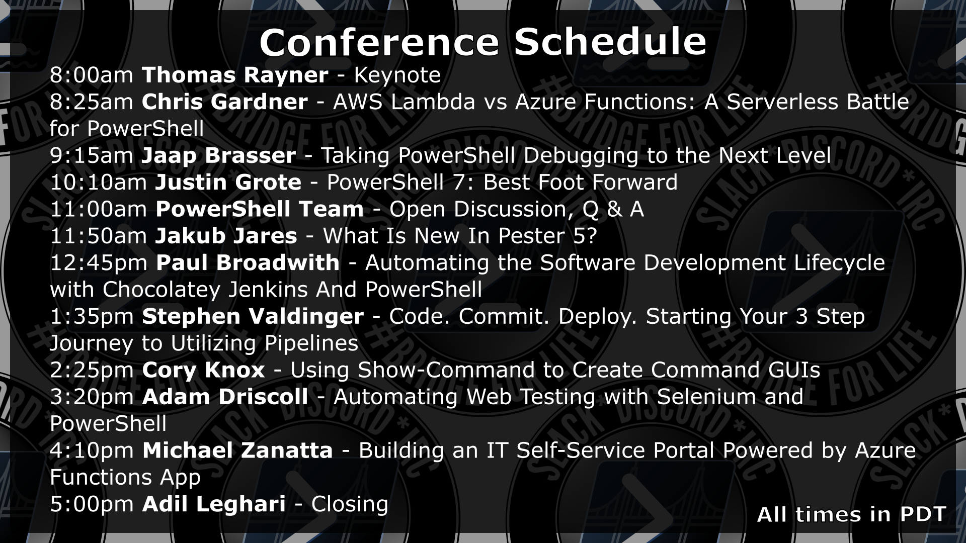

Slide 11
Thank you for joining us for
!#BridgeConf!
PowerShell Discord/Slack
aka.ms/psdiscord aka.ms/psslack
Adil Leghari @adilio | Thomas Rayner @MrThomasRayner | Cory Knox @CoryKnox
Notes:
Here are the links to join the PowerShell Discord and Slack bridged network, depending on which client you prefer.
I'm Thomas. Our other hosts and organizers today are Adil and Cory. You can find us all on the PowerShell Discord and Slack network, and on Twitter.
We really appreciate you joining us today for BridgeConf. We know you're going to get something great out of it.

